Slide 1
Progress Check
7/23

Slide 2
논문정리

Slide 3
Theme: The blind suffer from imbalance
Balance Control in Individuals With Visual Impairment: A Systematic Review and Meta-Analysis
Do visually impaired people have a static balance as effective as sighted people?
Impact of visual impairment on balance and visual processing functions in students with special educational needs
Visual, musculoskeletal and balance symptoms in individuals with visual impairment

Slide 4
Contents
A meta-analysis of 20 studies (1,280 participants) found that individuals with visual impairment have significantly worse static and dynamic balance than sighted peers (p = .001). Even visually impaired individuals who are active in sports have poorer balance than sighted people, but do better than their sedentary visually impaired peers
Focuses more on static balance
In a study of 104 students with special educational needs, dynamic and static balance was worse among visually impaired students. Balance deficits correlated with the severity of visual acuity loss, particularly affecting postural sway and reaction to unstable surfaces
increased risk of falls and postural instability, especially in older adults

Slide 5
Theme: Importance of arm movements
Angular momentum in human walking
Control and function of arm swing in human walking and running
Natural Arm Swing Saves Runners' Energy

Slide 6
Contents
“the neuromuscular control of arm swing in humans serves to counteract the angular momentum generated by the legs, stabilizing the torso.“-Herr, H., & Popovic, M. (2008). Angular momentum in human walking. Nature Neuroscience, 11(7), 746–747.
- Walking with restricted arm swing: - Increases **torso rotation by ~50%** - Increases **metabolic cost by ~12%** - Demonstrates that **arm swing actively damps rotational motion** of the trunk
torso, which accounts for ~40–50% of the total body mass, while both arms account for ~10% of the total body mass

Slide 7
Theme: Improving balance of visually impaired people
Effect of selected balance exercises on the dynamic balance of children with visual impairments
Improved balance performance accompanied by structural plasticity in blind adults after training
Physical activity and sport practice to improve balance control of visually impaired individuals: a narrative review with future perspectives

Slide 8
Contents
children with visual impairments following 8-week balance-training programs, with better dynamic balance scores noted after intervention
A study of blind adults (n=14) showed that 12 weeks of structured balance training led to significant improvements in both static and dynamic balance, which were accompanied by detectable changes in brain structure related to motor and spatial processing. After training, their balance improvement was comparable to that in sighted adults following similar intervention
Systematic review findings indicate that participation in sports and physical activity measurably improves balance control among the visually impaired, compared to those who remain sedentary. The effect is present even though levels often do not reach those of fully sighted individuals

Slide 9
Website

Slide 10
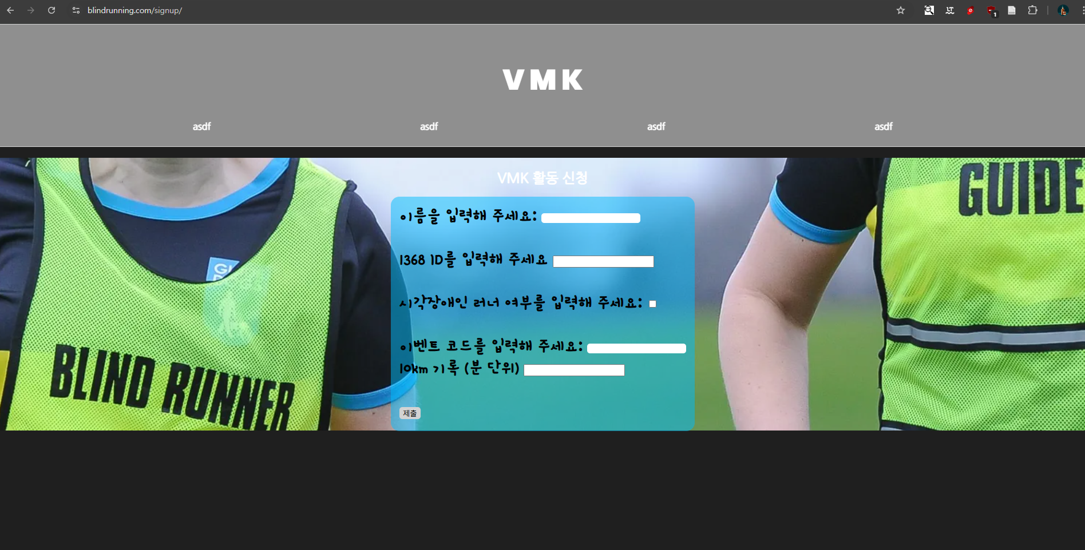
Signup

Slide 11
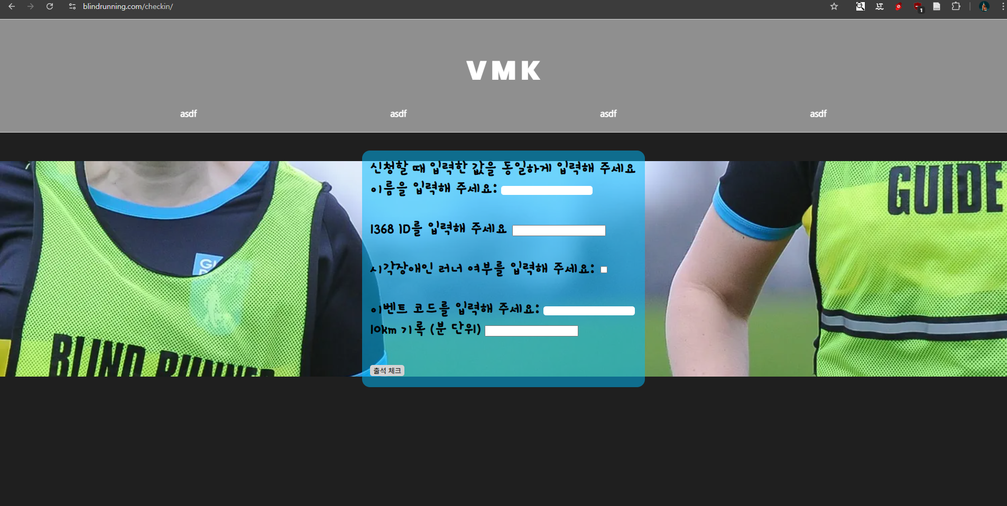
Checkin

Slide 12

Database

Slide 13
Openpose

Slide 14
Data Collection for Research

Slide 15
Reference
Integrating OpenPose and SVM for Quantitative Postural Analysis in Young Adults: A Temporal-Spatial Approach
OpenPose: Whole-Body Pose Estimation

Slide 16
See for yourself
https://github.com/WhateversOnMyMind/openpose

Slide 17
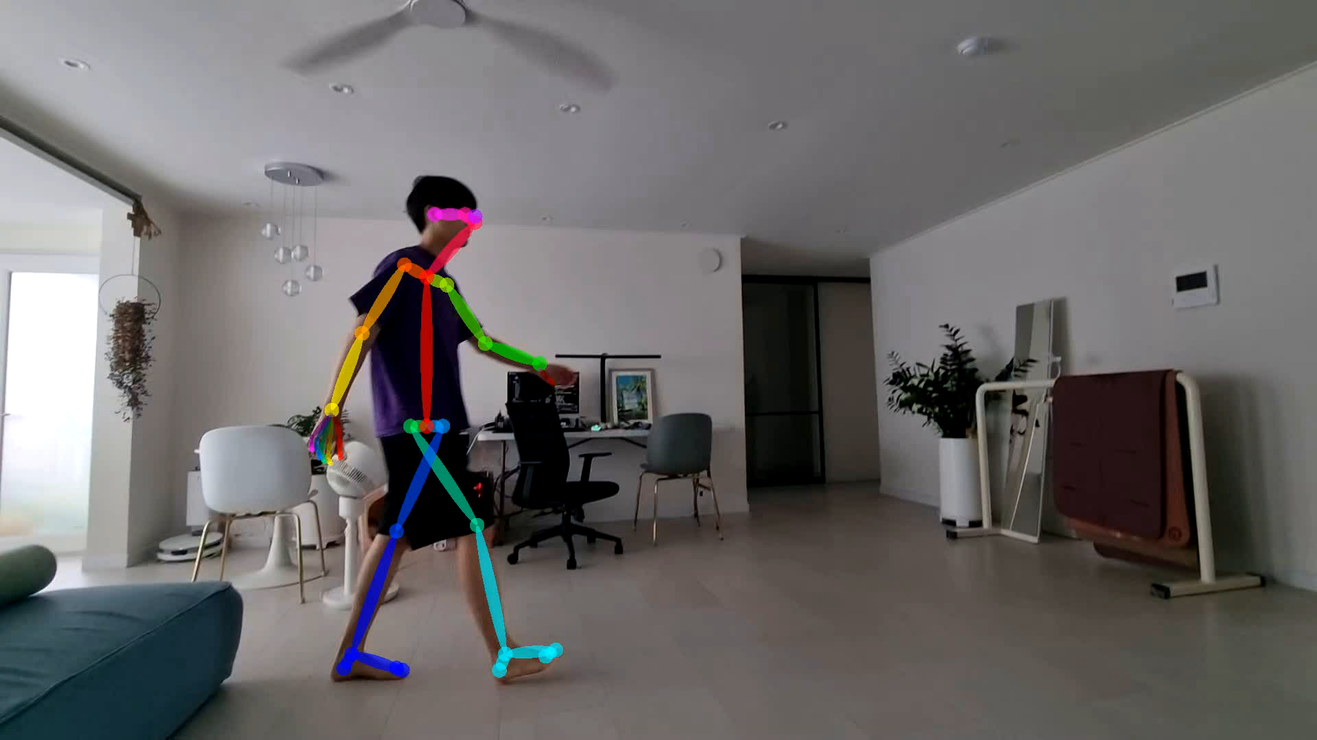
Output

Slide 18
Data
PS C:\Users\PC\openpose> py analyze_side.py
--- Side‑view posture report (327 frames) ---
forward_head: mean=0.078 sd=0.034 n=249
→ posture score: 3.91 / 5.00
spine_tilt : mean=2.870 sd=2.322 n=315
→ posture score: 1.43 / 5.00
knee_flex : mean=152.735 sd=20.888 n=311
OVERALL POSTURE SCORE: 2.67 / 5.00
PS C:\Users\PC\openpose>

